Slide 1

DECISION TREES
IN ARTIFICIAL INTELLIGENCE
Presented by:
Juhi Surin (192525148)
Mokshitha Kilari(192525413)
Chandana K(192525363)
Under the supervision:
Dr. Subramanian P

Slide 2


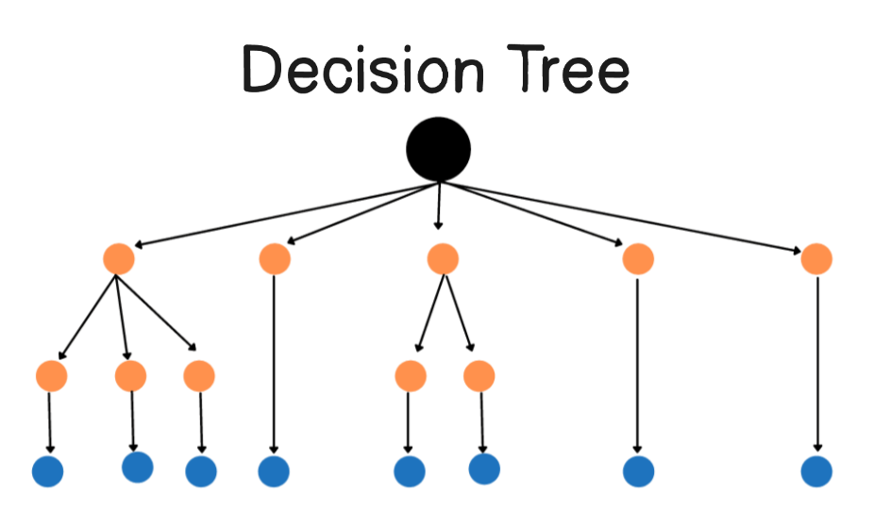
Introduction to Decision Trees
A Decision Tree is a machine learning technique used for classification and prediction.
It makes decisions by dividing a problem into smaller and simpler conditions.
Each decision is represented in the form of a tree-like structure.
The model follows a sequence of questions to reach a final decision.
Decision Trees are widely used because they are simple, interpretable, and effective.

Slide 3
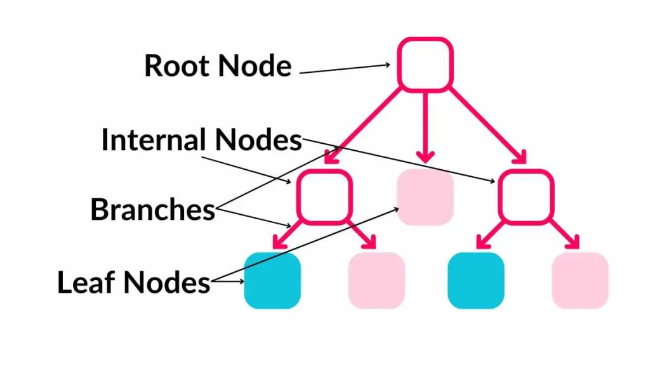
Basic Structure of a Decision Tree
Main Components:
Root Node: Represents the first and most important decision.
Internal Node: Represents a condition or test on a feature.
Branch: Represents the possible outcome of a decision.
Leaf Node: Represents the final prediction or decision.
Path: Represents the sequence of rules followed to reach a conclusion.

Slide 4
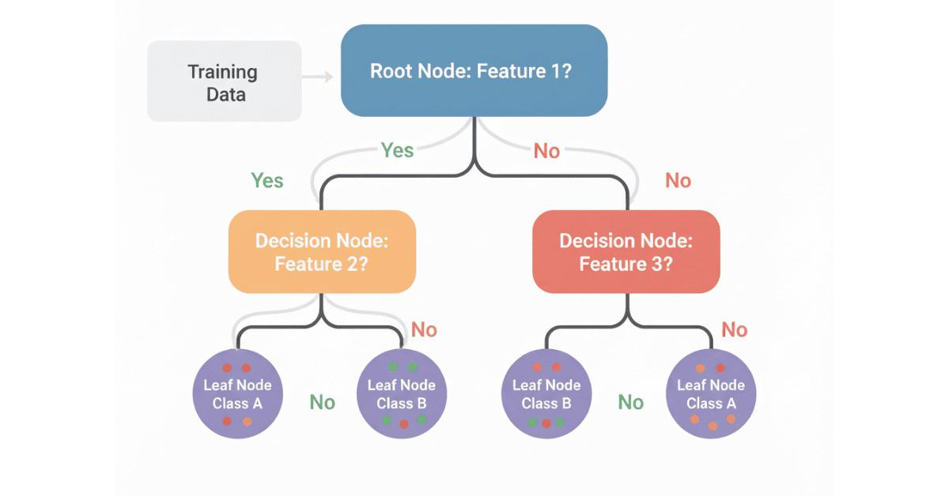
How a Decision Tree Works
The algorithm first receives a dataset containing input features and expected output values.
It analyzes all available features to identify the best feature for the first split.
The data is divided into different branches according to the selected condition.
The same process is repeated until the data reaches a final decision or stopping condition.
For example, the model may check attendance, marks, assignments, and study hours before predicting performance.

Slide 5
Decision-Making Criteria
Decision trees use mathematical techniques to choose the best question for splitting data.
Entropy:
Measures the uncertainty or randomness in the data.
Information Gain:
Measures how much useful information is gained after a split.
Gini Index:
Measures how pure or mixed the groups are after splitting.
The algorithm selects the split that gives the best separation between data.

Slide 6
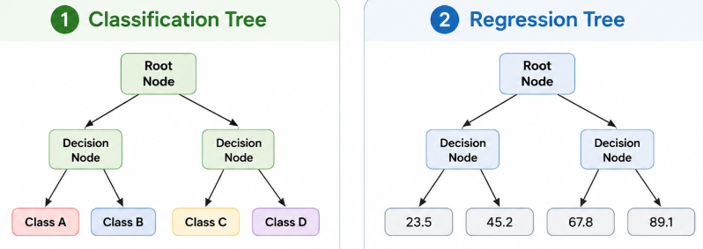
Types of Decision Trees
A Classification Tree is used when the output belongs to a specific category or class.
For example, a Classification Tree can predict whether a student will Pass or Fail.
A Regression Tree is used when the output is a continuous numerical value.
For example, a Regression Tree can predict a student's expected final examination mark.
Therefore, Decision Trees can solve both categorical classification and numerical prediction problems.

Slide 7
Application: Student Performance Prediction
How Decision Trees Help Predict Student Performance
A Decision Tree can analyze factors such as attendance, previous marks, assignment scores, study hours, and class participation.
The system first checks important conditions, such as whether the student's attendance is above 75 percent.
It then analyzes academic performance, such as whether previous examination marks are above 60 percent.
Based on these conditions, the model can classify the student as Good Performance, Average Performance, or Needs Improvement.
This prediction helps teachers provide early guidance and personalized support to students who may be academically at risk.
Example:
Attendance > 75% → Previous Marks > 60% → Good Performance
Attendance < 75% → Needs Improvement

Slide 8
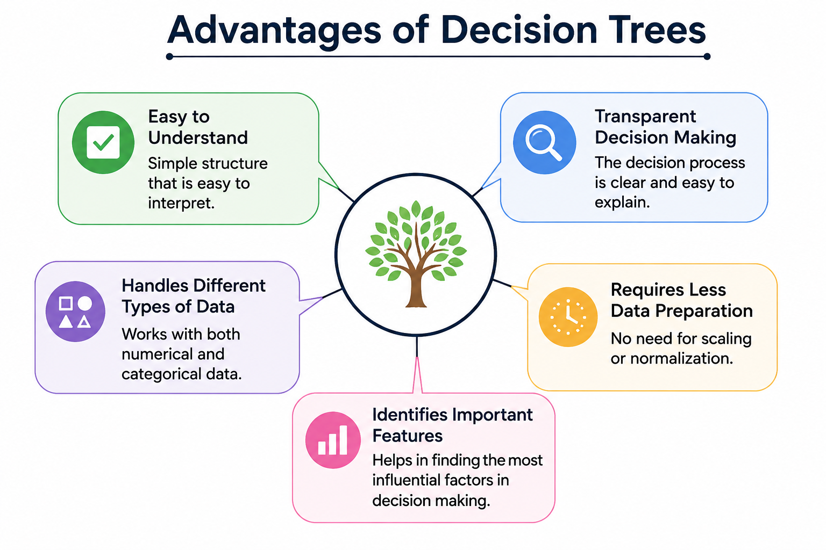
Advantages
Decision Trees are easy to understand because their structure is similar to human decision-making.
The tree structure can be visually represented, making the prediction process easy to explain.
They can handle both numerical data, such as marks, and categorical data, such as performance levels.
They require relatively less data preparation compared with some other machine learning algorithms.
They can identify important factors that have a strong influence on the final prediction.

Slide 9
Limitations
A Decision Tree can become overly complex when it creates too many branches from the training data.
An overly complex tree may suffer from overfitting and perform poorly on new student data.
Small changes in the dataset can sometimes result in a significantly different Decision Tree.
The prediction quality depends heavily on the accuracy and completeness of the student data provided.
Techniques such as Pruning and Random Forest can be used to improve the model's reliability.

Slide 10
CONCLUSION
Decision Trees are powerful Artificial Intelligence tools that make predictions through logical conditions.
Their simple tree-like structure makes complex decisions easier to understand and interpret.
They can be used for both classification problems and numerical prediction problems.
Student Performance Prediction demonstrates how Decision Trees can solve an important real-world educational problem.
Therefore, Decision Trees can help transform educational data into meaningful insights and support better decision-making.
Decision Trees transform data into clear, logical, and intelligent decisions.

Slide 11
THANK YOU

